Slide 1

Statistics, an unreliable friend
Magnus Ahlkvist

Slide 2










Our Partners
Platinum
Gold
Silver
Bronze
Notes:
If you think, that a SQL Saturday is a nice possibility to learn from and network with fellow SQL Server enthusiasts FOR FREE,
I just ask you one thing: Visit the sponsor booths and chat with the sponsors!
They are covering the expenses for each and every of you, with is around EUR 60 …

Slide 3
About Magnus
Magnus Ahlkvist
Transmokopter SQL AB – database consultant
Abbreviations.

Slide 4
Session contents (Not necessarily in this order…)
Ascending key
Missing key
Statistics
Case study

Slide 5
Why did I make this presentation?
System for reporting financial statistics
Tight deadline
Bad performance on reporting day => Reporting done late => ECB unhappy => DBA being yelled at => I’m unhappy

Slide 6
Session scenario
Order system
Ship orders to warehouse system
All good. Until not good.

Slide 7
Problem specifics
Getting orders for yesterday and before => Fast
Getting today’s orders => Not fast

Slide 8
DEMO

Slide 9

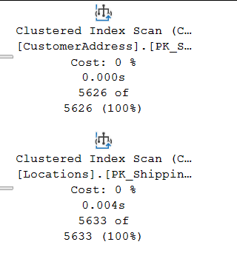
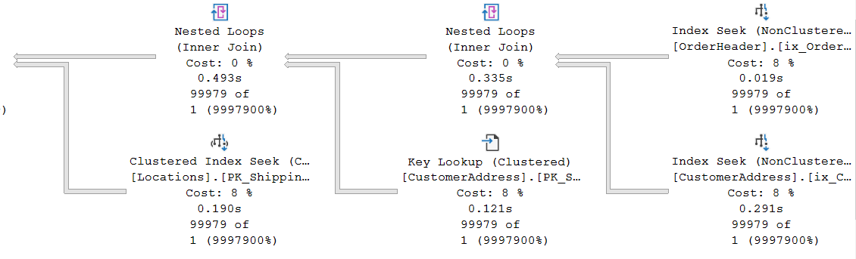
Some plan characteristics
OK
Awful

Slide 10
Hey Mr DBA
Ola Hallengren’s maintenance solution, run nightly

Slide 11
DBCC SHOW_STATISTICS
DEMO

Slide 12
Statistics histogram
RANGE_HI_KEY | RANGE_ROWS | EQ_ROWS | DISTINCT_RANGE_ROWS | AVG_RANGE_ROWS
Upper limit of a bucket (sqlvariant). A distinct value from the leading column in the index/statistics object. | Number of rows in the bucket, smaller/lower than the value of RANGE_HI_KEY | Number of rows in the bucket with value exactly RANGE_HI_KEY | Number of unique values for the leading column of the index/statistics object in the bucket | Average rows per distinct value within the bucket

Slide 13
Density vector
Density of leading column, then two leading columns in combination, then three leading columns…
Density = NoDistinctValues / NoRows
Gender = High density, SSN = Low density
Low Selectivity = High Density

Slide 14
Ascending Key Problem
Can also be missing key-in-the-middle problem

Slide 15
Suggestions?
Notes:
Parameterize
Get the value from a table in the DB
Trace Flags handling ascending key problem
Update statistics and/or rebuild index
Upgrade
Partition
Optimize for unknown

Slide 16
Let’s try to fix it
DEMO

Slide 17
Is there a silver bullet?
…or is it ”It depends”?

